Slide 1
Optimizing OpenGL for iPhone
Tim Omernick
ngmoco:)

Slide 2
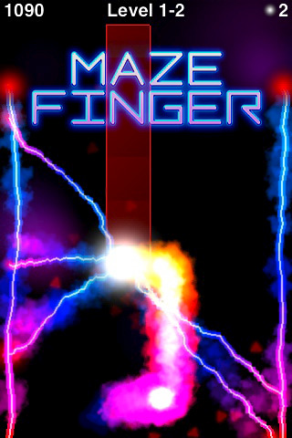
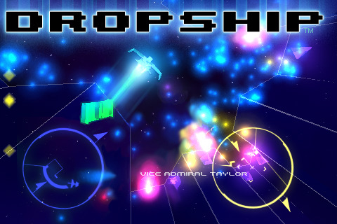
Introduction
Tim Omernick, ngmoco:) Creative R&D
MazeFinger
Dropship

Slide 3
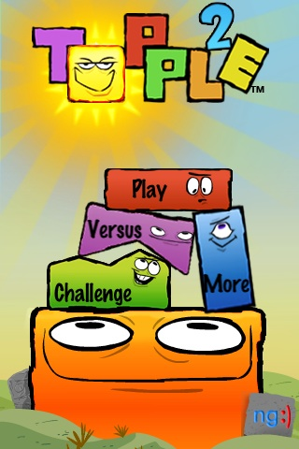
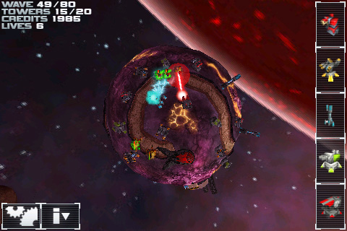

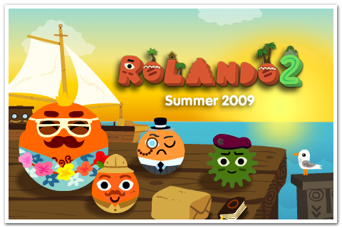
ngmoco:) games

Slide 4
What You’ll Learn
A simple game
Optimization: First pass
The last 5%

Slide 5
Why OpenGL?
Fastest way to get bits to screen
Games
2D and 3D
Custom application effects
Cross-platform
Code samples, ports

Slide 6
iPhone & OpenGLES
OpenGLES 1.1
Fixed-function (no vertex or pixel shaders)
Many FX use blending or vertex / UV transforms
No immediate mode: vertex arrays only

Slide 7

Fireworks

Slide 8
Some Problems
Animation is sluggish
Controls are not responsive
Good idea, poor execution

Slide 9
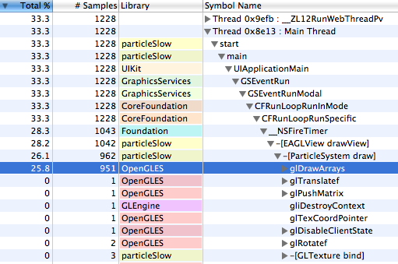
Always Take a Sample!

Slide 10
RTFM
Read:
POWERVR 3D Application Development Recommendations
http://www.imgtec.com/factsheets/SDK/PowerVR%20MBX.3D%20Application%20Development%20Recommendations.1.0.67a.External.pdf
Drawing with OpenGL ES
http://developer.apple.com/iphone/library/documentation/iPhone/Conceptual/iPhoneOSProgrammingGuide/GraphicsandDrawing/GraphicsandDrawing.html#//apple_ref/doc/uid/TP40007072-CH10-SW27

Slide 11
Optimization Strategy
Batch Geometry
Texture Atlases
Interleaved Arrays
Indexed Triangles
Floats vs. Shorts

Slide 12
Batching Geometry
Minimize OpenGL draw calls
glDrawArrays, glDrawElements
Can draw multiple objects in one call
Avoid changing state
glBindTexture
glEnable, glColor, etc.
iPhone OpenGLES does not check for redundant state changes!

Slide 13



Texture Atlas
Combine small textures into larger “texture atlases”
Useful for animated sprites
Or many separate sprite images
+

Slide 14
Interleaved Arrays
One large array with each vertex followed by its attributes:
XYZ RGBA UV, XYZ RGBA UV, XYZ RGBA UV…
Instead of separate arrays:
XYZ XYZ XYZ …
RGBA RGBA RGBA …
UV UV UV ...
Maximizes memory access efficiency
Reduces driver overhead

Slide 15
Indexed Triangles
Can be very memory efficient
Multiple triangles can share vertices
Submit in “triangle strip order” for minimum driver overhead
i.e. triangles adjacent in memory should form triangle strips
Not very useful in Fireworks app because the particles rarely have coinciding vertices
Floats vs. Shorts
iPhone is faster at floating-point math
But it draws short (2-byte) geometry faster!
Usually a gain to convert to short before submitting to OpenGL
Vertex data
Colors
Texture coordinates

Slide 16
Texture Compression
PVRTC: 4-or-2 bit compression
Reduces memory use
Compressed data = higher throughput
Texturetool included with iPhone SDK
/Developer/Platforms/iPhoneOS.platform/Developer/usr/bin/texturetool

Slide 17
Fireworks ( again :P )

Slide 18
Questions?
tim@ngmoco.com

Slide 19
Open Source
Fireworks app source code will be posted today here:
gamemakers.ngmoco.com

